Slide 1

Smart Urban Traffic Optimization for Emergency Services and Prioritization System Inhouse Project
Review - III / Sem 6
Group Number : 43
Group Members : Atharva Hande - 67 / D12B
Aryan Surve - 67 / D12A
Tarunkumar Gatla - 71 / D12A
Sanchet Khemani - 21 / D12B
Project Mentor : Mrs. Pallavi Saindane

Slide 2
Content
Introduction to Project
Lacuna in the existing systems
Problem Definition
Literature Survey
Methodology employed
Algorithms used in Smart Traffic Signalling System
Difference between yolo version
Hardware, Software, tools and the constraints
Block Diagram
Modular Diagram
Detailed Architecture
Conclusion
References

Slide 3
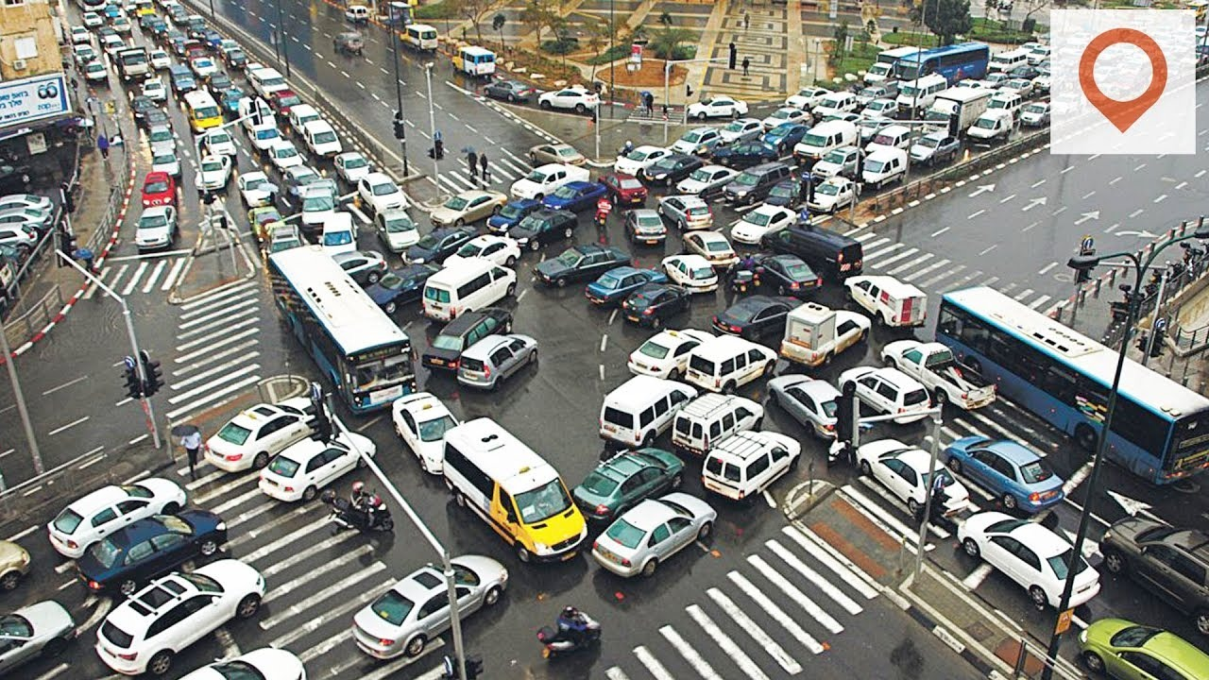
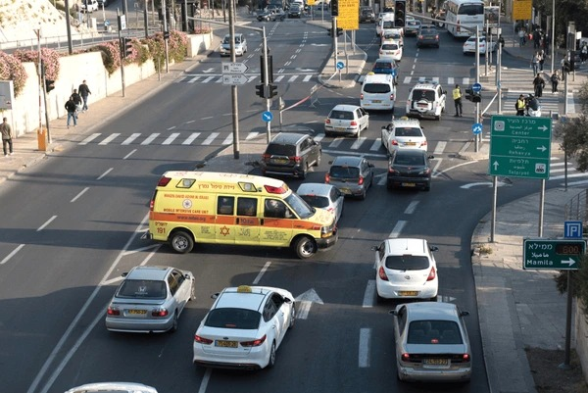
Introduction to Project
In congested urban environments, optimizing traffic for emergency services is critical. The "Smart Urban Traffic Optimization for Emergency Services and Prioritization System" uses real time traffic videos to dynamically adjust traffic signals and manage flow.
This approach aims to prioritize emergency vehicles, reduce response times, and enhance overall traffic management, addressing the challenges of urban congestion effectively.

Slide 4
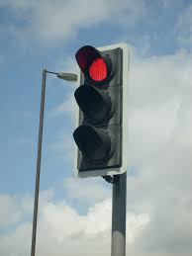
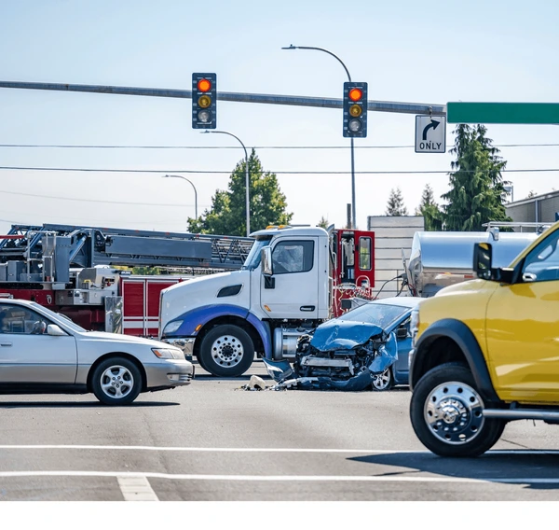
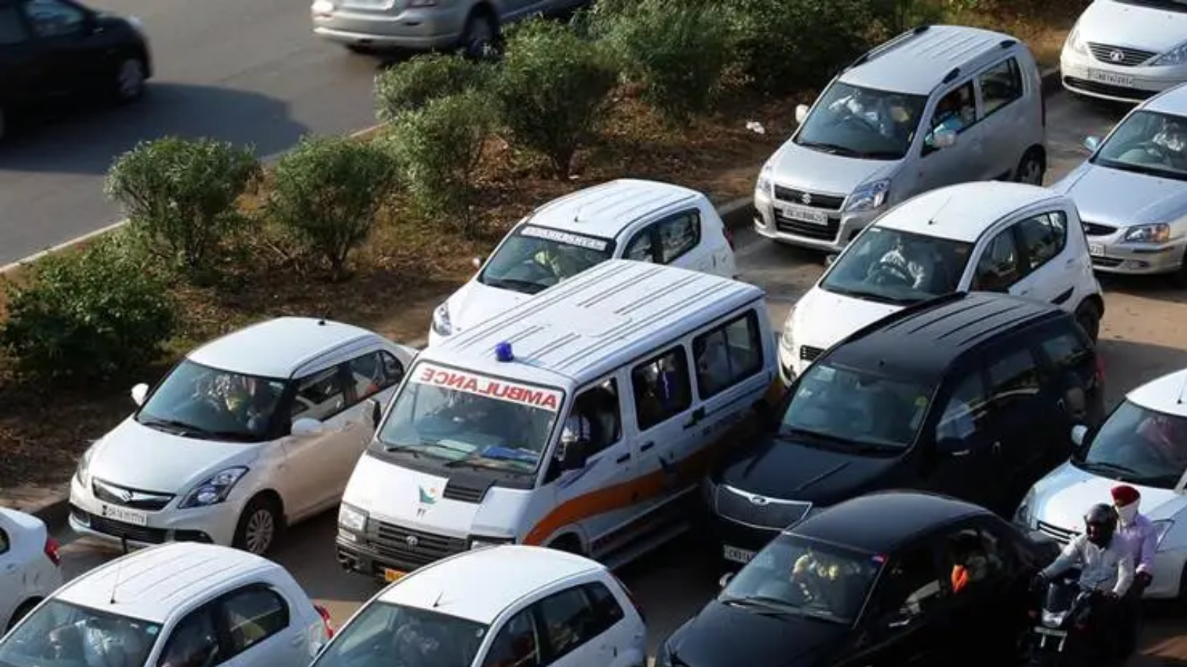
Lacuna in the existing system
The system lacks real-time adaptability to dynamic traffic conditions and seamless integration with emergency service networks. Additionally, it may face challenges in accurate vehicle prioritization and efficient rerouting

Slide 5
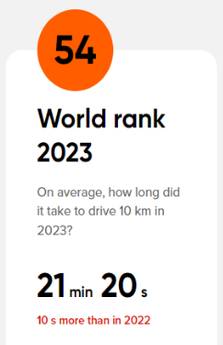
Problem Definition
In urban environments, inefficient traffic signal management leads to significant traffic congestion, delays, and increased pollution. Traditional traffic signal systems operate on fixed schedules and fail to dynamically adjust to real-time traffic conditions, causing unnecessary waiting times for vehicles even when roads are clear or underused. This inefficiency contributes to fuel wastage, increased emissions, and driver frustration. The challenge is to develop an intelligent traffic signal automation system that can adapt in real-time

Slide 6
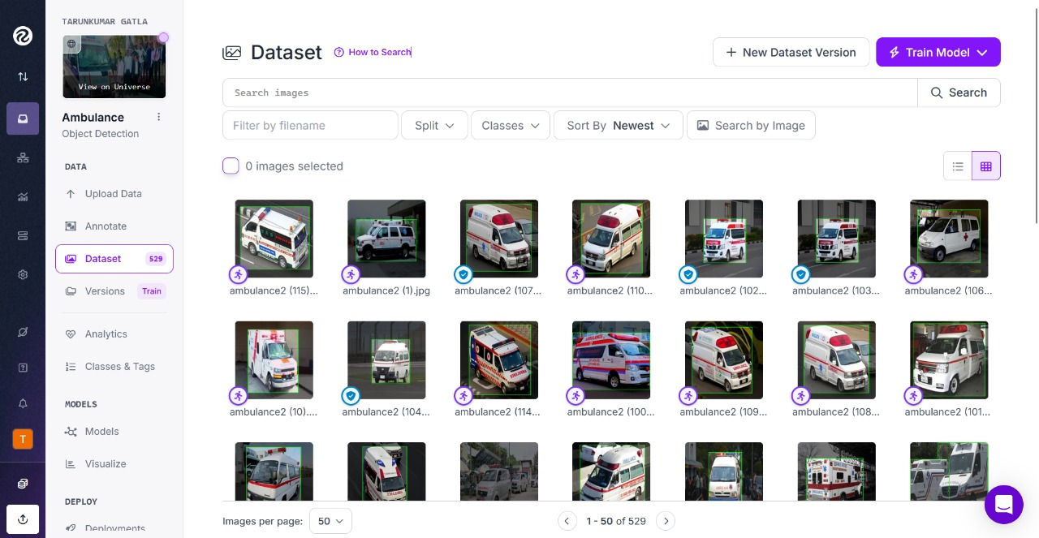
Methodology
Dataset Collection
Gather images of various vehicle types (autorickshaws, buses, cars, taxis, bikes, ambulances, etc.). Ensure the dataset covers different angles, lighting conditions, and road environments for robustness.
Use Roboflow to annotate the images, drawing bounding boxes around vehicles.
Assign labels/classes to each vehicle type.
Generate and export the dataset in YOLO format.

Slide 7
Smart Traffic Signalling System
To make a Smart Traffic Signaling Mechanism that effectively reduces traffic congestion and prioritizes emergency vehicles, we need a hybrid algorithm that integrates multiple techniques. The Smart traffic signaling mechanism requires efficient decision-making to prioritize emergency vehicles while optimizing overall traffic flow Algorithms used :
Priority Queue (Heap - Based Scheduling).
Shortest Remaining Time First (SRTF) for Lane Selection
Dynamic Traffic Light Timing (Adaptive Signal Control Algorithm - ASCT)

Slide 8
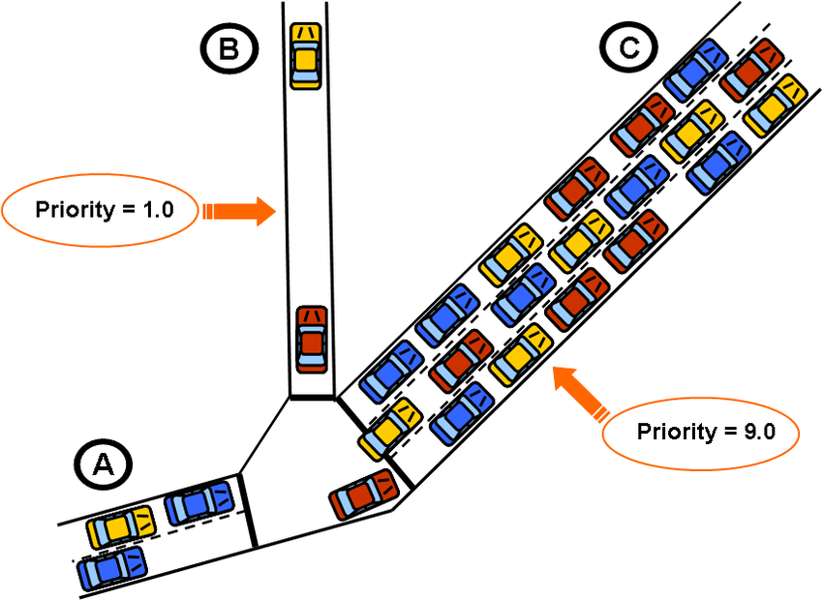
Priority Queue (Heap Based Scheduling)
What is Priority Queue (Heap) for Lane Selection?
A Heap (Priority Queue) is used to dynamically manage lane priorities.
Emergency vehicles (ambulances, fire brigades) will get the highest priority.
Dynamically adapts to real-time traffic density.
If no emergency vehicles exist, the lane with the highest normal token count (traffic density) gets priority.

Slide 9
Shortest Remaining Time First (SRTF)
How Shortest Remaining Time First (STRF) works ?
Calculate Clearance Time Using Tokens:
Clearance Time = (Normal Tokens in Lane) ÷ (Fixed Exit Rate per Token) + (Special Tokens in Lane) ÷ (Fixed Exit Rate per Token)
Normal Tokens: Bus = 4, Car = 2, Truck = 5, Bike = 1, etc.
Special Tokens: Ambulance = 5 (Higher priority).
Lane Selection Process:
Step 1: If an emergency vehicle exists in a lane, prioritize it first.
Step 2: Among the remaining lanes, select the one with the lowest clearance time.
Step 3: If two lanes have the same clearance time, pick the lane that has been waiting the longest.
Real-Time Dynamic Updates.
Features of Shortest Remaining Time First (SRTF):
Minimizes total waiting time by clearing lanes with the shortest clearance time first.
Ensures faster movement of vehicles, reducing congestion.
Prioritizes lanes based on token-based clearance estimation..

Slide 10

Dynamic Traffic Light Timing System
How Dynamic Traffic Light Timing system works
Eg: Normal token : BUS - 4 , CAR - 2, TRUCKS - 5, BIKE - 1.
Special token : Ambulance (Emergency Vehicle) - 5.
If No Emergency Vehicles,
It provides special delay which prevents from frequent change in
signals.
Features of Dynamic Traffic Light Timing system :
Prevents unnecessary long waits at signals.
Ensures efficient traffic flow and reduces frequent change in signals by inserting delays.

Slide 11
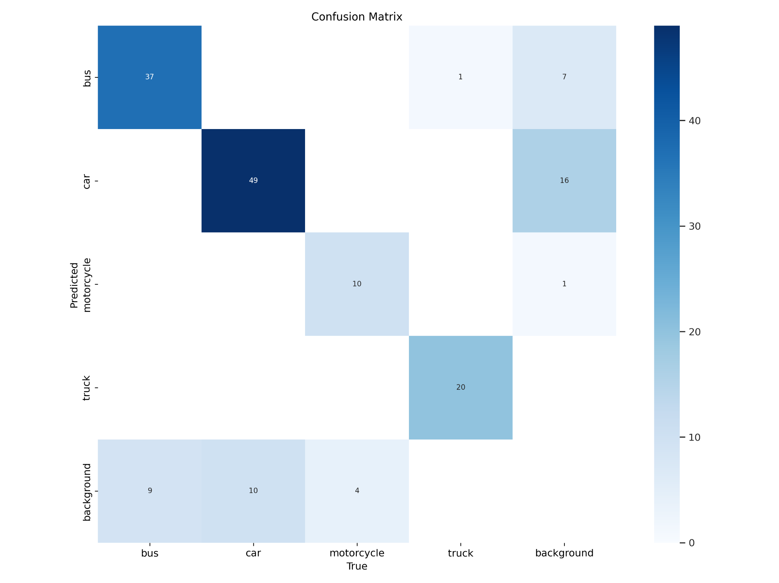
YOLO 8
Accuracy : 70.7317 %

Slide 12
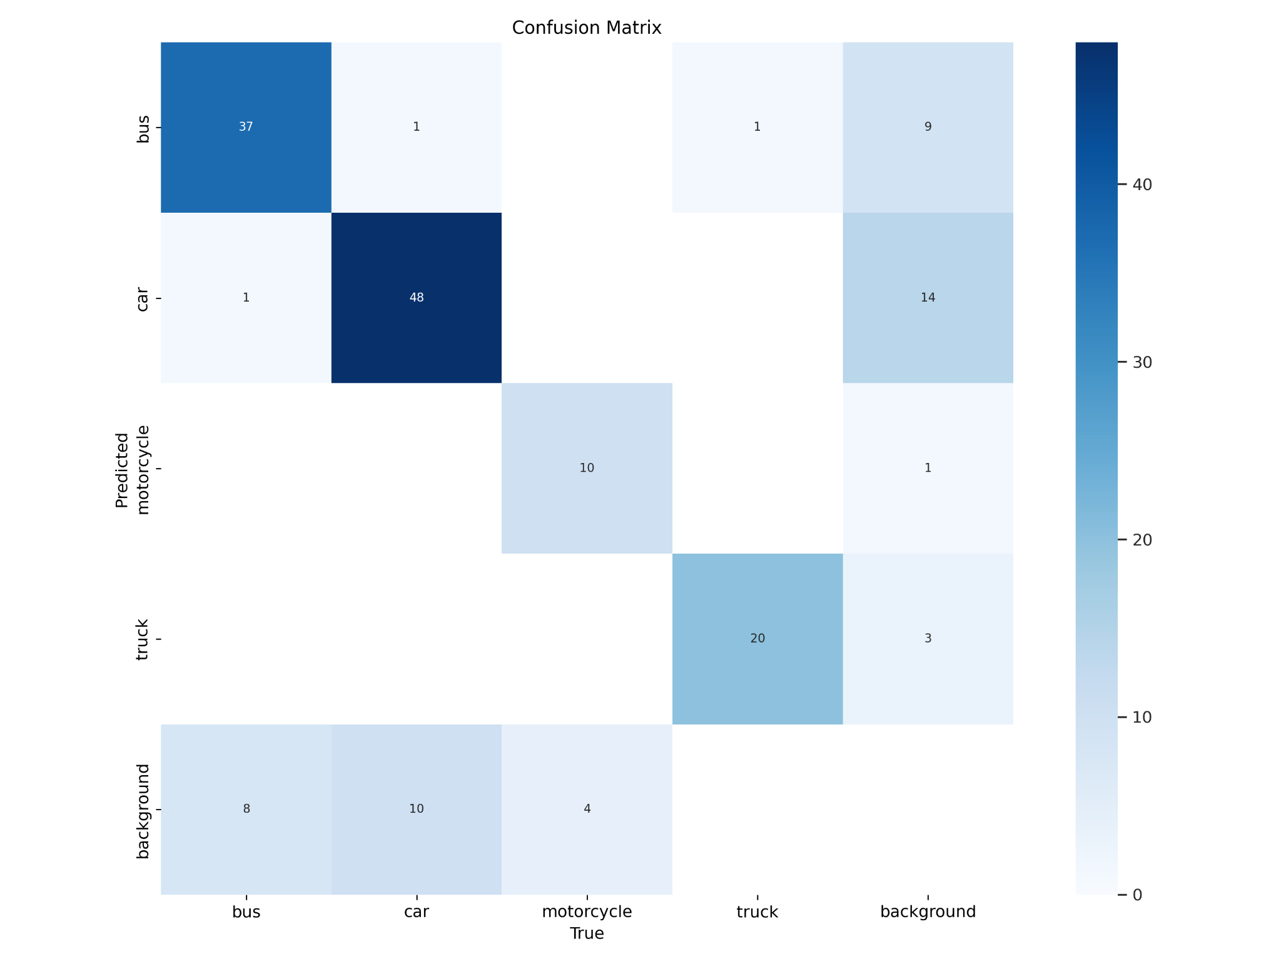
YOLO 9
Accuracy : 68.8623 %

Slide 13
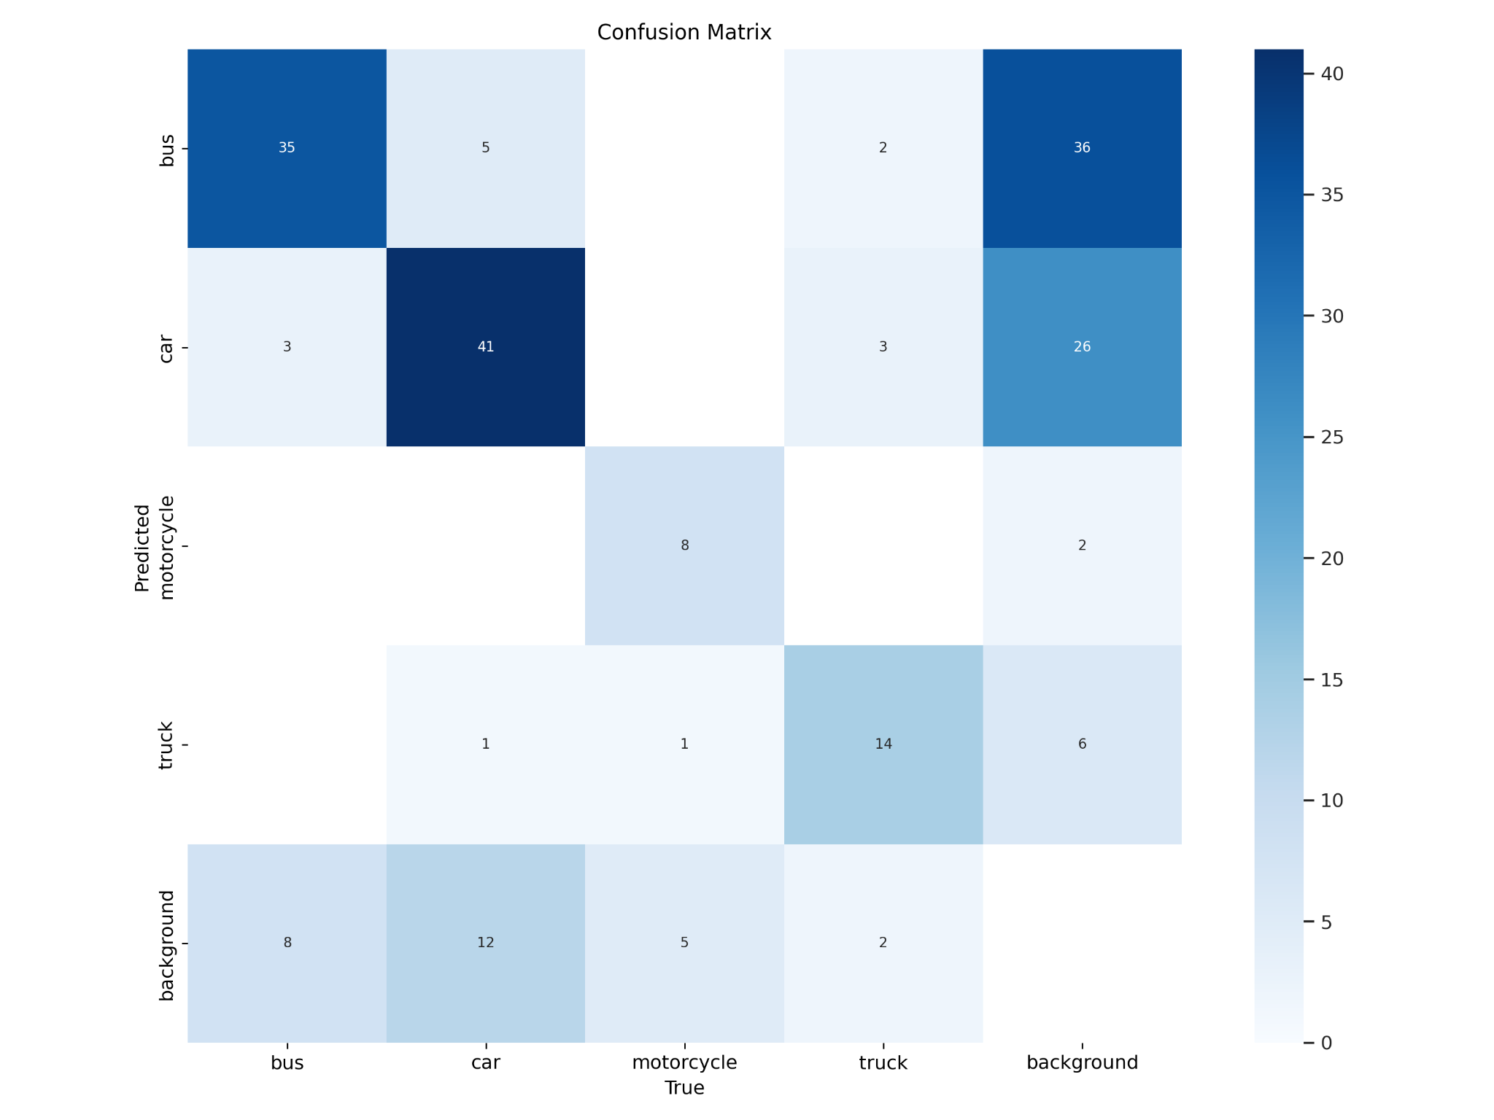
YOLO 11
Accuracy : 46.6667 %

Slide 14
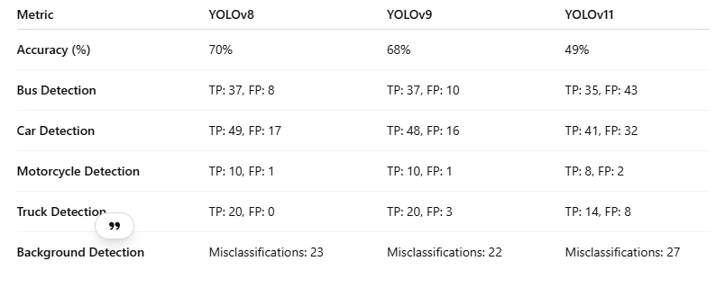
Difference Between Yolo Versions
So This is how our dataset performs on different yolo versions

Slide 15
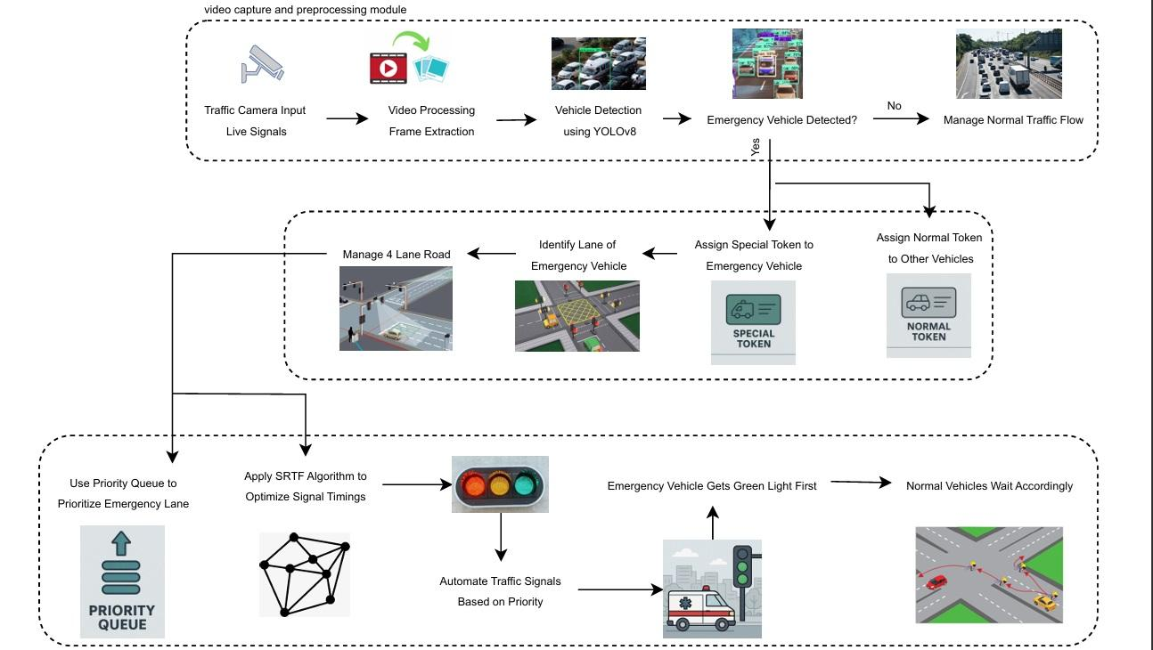
Detailed Architecture

Slide 16
Hardware, Software, Tools and constraint
Hardware Requirements:
Processor: Multi-core CPU (e.g., Intel i7/i9,AMD Ryzen 7/9).
Memory: 16 to 32 GB RAM.
Storage: 100GB SSD
Components : GPS, Sensors,Raspberry Pi, NVIDIA Jetson Nano,ESP32 and relay modules,AWS, Registers,Raspberry Pi Camera,
Software Requirements:
Algorithms: ML, Yolo Model
Frontend: HTML, CSS, ReactJs.
Backend: ExpressJs, MongoDB.

Slide 17
Hardware Components
RaspberryPi:
A low-cost, credit-card-sized computer developed by the Raspberry Pi Foundation.
🔹 Key Features:
ARM-based CPU with various models (Pi 4, Pi 5, etc.)
Runs Linux-based OS (Raspberry Pi OS, Ubuntu, etc.)
Multiple USB ports, HDMI, GPIO pins for hardware projects
Supports Python, C++, and other programming languages

Slide 18
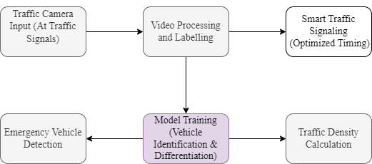
Block Diagram

Slide 19
Modular Diagram
05
Smart Traffic Signalling
Traffic signaling is managed by smart traffic signals with optimized timing.
Traffic Video Input
Collecting Traffic Data from youtube and open Source Platform
01
04
Emergency Vehicle Detection
Depending on the Trained Model the Traffic density is calculated and Emergency vehicles are detected
Video Processing and Labelling
Video is processed and labelled accordingly
02
03
Model Training
Identifying multiple vehicles and differentiate between cars n emergency vehicles a model is trained

Slide 20
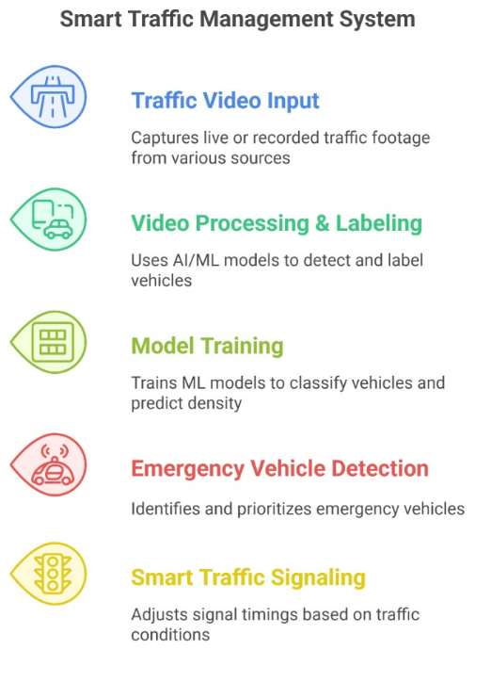
Modular Diagram

Slide 21
Next Work Plan
1. Integration with RFID Technology
Implement RFID-based vehicle tracking to detect when a vehicle crosses a checkpoint.
Classify vehicles as normal or special (e.g., emergency, VIP) based on RFID tags.
2. Advanced Traffic Signal Control
Prioritize emergency vehicles by detecting special RFID tags and adjusting signals accordingly.
3. Sensor-Based Traffic Management
Deploy ground sensors to verify vehicle presence at intersections.
Integrate IoT-enabled sensors to enhance accuracy
4. Traffic Signaling with LED Display
Implement LED-based traffic signals controlled using resistors and microcontrollers.
Adjust signal timings dynamically based on vehicle count and emergency conditions and display the signals .

Slide 22
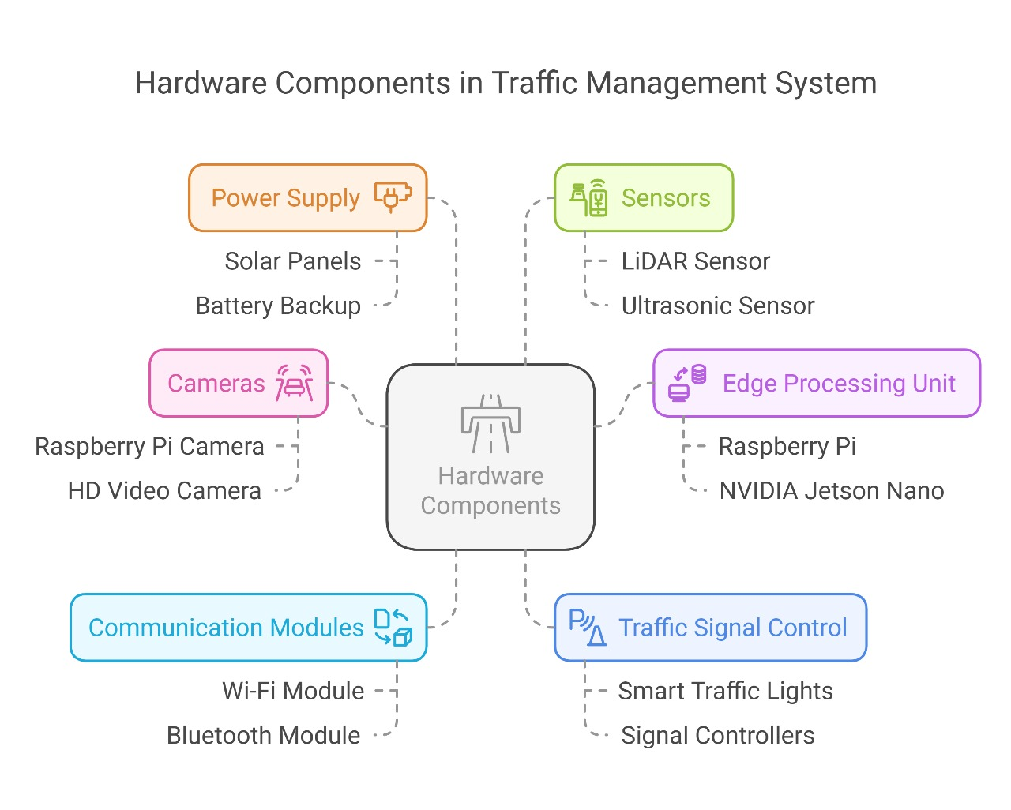
Next Work Plan

Slide 23
Conclusion
In conclusion, our system utilizes open-source datasets combined with AI-driven classification techniques to efficiently detect and prioritize emergency vehicles across multiple traffic lanes. By adopting a modular design, we structured the workflow to ensure smooth data preparation, real-time traffic data processing, and lightweight deployment suitable even for low-resource IoT devices. The integration of Priority Queue algorithm, SRTF etc allows for intelligent decision-making, ensuring that emergency vehicles are given precedence at intersections without causing major traffic disruptions. Our approach is scalable, resource-efficient, and designed for real-world applications, aiming to transform urban traffic systems into smarter, faster, and more responsive networks that effectively cater to critical and emergency needs.

Slide 24
References
M. A. Hossain, A. Rahman, and M. M. Alam, "Dynamic Traffic Light Controlling System Using Google Maps and IoT," International Journal of Scientific Research in Science and Technology, vol. 8, no. 5, pp. 250-257, Dec. 2020.
PLOS, "Mobile Phones in a Traffic Flow: A Geographical Perspective to Evening Rush Hour Traffic Analysis Using Call Detail Records," 5 9 2020+
P. Jain, "Automatic Traffic Signal Controller for Roads by Exploiting Fuzzy Logic," in International Conference on Advances in Communication, Network, and Computing, Berlin, 2011.
T. V. Janahiraman and M. S. M. Subuhan, "Traffic Light Detection Using Tensorflow Object Detection Framework," in IEEE International Conference on System Engineering and Technology, 2019.
[1] A. Charef, Z. Jarir, and M. Quafafou, "Smart System for Emergency Traffic Recommendations: Urban Ambulance Mobility," International Journal of Advanced Computer Science and Applications, vol. 13, no. 10, pp. 1-8, 2022.
[2] F. I. Sapundzhi and M. S. Popstoilov, "Optimization algorithms for finding the shortest paths," Bulgarian Chemical Communications, vol. 50, Special Issue B, pp. 115-120, 2018.

Slide 25
References
7. [3] Sarpal, Deepika & Hota, Malaya Kumar. (2020). Article ID: IJEET_11_06_001 Cite this Article: Deepika Sarpal, Yatharth Asthana and Dr Malaya Kumar Hota, Review on Smart Traffic Management System for Ambulance. INTERNATIONAL JOURNAL OF ELECTRICAL ENGINEERING AND TECHNOLOGY. 11. 10.34218/IJEET.11.6.2020.001.
8. [4] P. Devi and S. Anila, "Intelligent Ambulance with Automatic Traffic Control," 2020 International Conference on Computing and Information Technology (ICCIT-1441), Tabuk, Saudi Arabia, 2020, pp. 1-4, doi: 10.1109/ICCIT-144147971.2020.9213796

